Slide 1
WEB APPLICATION DEVELOPMENT TRAINING
INTRODUCTION TO JAVASCRIPT

Slide 2
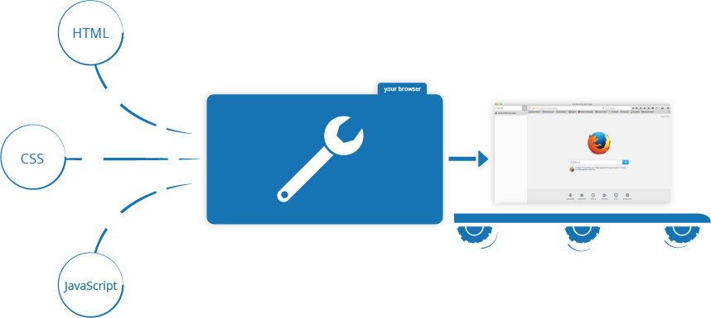
What then is this Java of a script?
Notes:
While HTML is used to place web elements on the page, CSS is used to beautify the elements overwriting the default ways in which the browsers show them. Javascript adds interactivity and dynamism to the web pages.

Slide 3
What then is this Java of a script?
Javascript, (JS) is a programming language that enables you to create dynamically updating content, control multimedia, animate images on the client side (browser).
In its most common form, JavaScript resides inside HTML documents, and can provide levels of interactivity to web pages that are not achievable with simple HTML

Slide 4
Whetting Your Appetite
JavaScript and Java are completely different languages, both in concept and design.
JavaScript enables you to add powerful interactions to websites
Understanding JS will teach the fundamental programming concepts
Programming is like writing a list of instructions to the computer so that it can do a number of things
<input type="button" value="Format My Hard Drive Now" onclick="return confirm('Are you really sure you want to do this?')";/>

Slide 5
Placement of JS
JavaScript statements are placed within the <script>... </script> HTML tags in a web page.
Has two attributes namely:
  Language − specifies the scripting language, value will be javascript.
  Type − indicates the scripting language in use and its value is set to "text/javascript“
Browsers have features that disables/enables Javascript

Slide 6
Placement of JS
Javascript can be included in any of the 3 ways namely: Inline (within the tag), internal (within the script tag), or as external file
Javascript can be included from any part of the page but the following are recommended:
  If you want to have a script that responds to event, (in a function) let it stay within the head section
  If you need a script to run as the page loads so that the script generates content in the page, then the script goes in the <body> portion of the document.

Slide 7
Adding Javascript to Your Webpage
Internal: Included on your HTML document using the script tag <script> // JavaScript goes here </script>
External file: <script src="script.js"></script>
Inline like the example in the previous slide
Javascript is a programming language for instructing the browsers on what to do
In HTML, JavaScript statements are "instructions" to be "executed" by the web browser.
Notes:
Note that Javascript is an action word, tells the computer what to do as opposed to HTML, CSS Bootstrap that tells the browser how to display elements

Slide 8
Things to Know in Javascript
Javascript statement: JavaScript programs contain many JavaScript statements.
The statements are executed, one by one, in the same order as they are written.
JS statements are separated by semicolon at the end of each executable statement
Execute the below to see how JS add dynamism to your website
<script>
document.getElementById("moat").innerHTML = "Just Relax... You will still understand Java script!";
</script>
Notes:
Ending statements with semicolon is not required, but highly recommended.
Script: this is working on the HTML tag whose id is “moat”

Slide 9
Things to Know in Javascript
JavaScript ignores multiple spaces. You can add white space to your script to make it more readable.
Keywords are used by the programming language for some specific things
Javascript comment is // for single line or
/*…… */ for multiple lines
Notes:
Ending statements with semicolon is not required, but highly recommended.

Slide 10
The building blocks of Javascript
Variables: when instructing the browser on what to do, you sometimes need to store some values.
JavaScript variables are containers for storing data values.
JavaScript variables can hold numbers like 100 and text values like “Victoria". They are created using var variable name
All JavaScript variables must be identified with unique names
<script>
var academy= “Moat";
alert (academy);
</script>

Slide 11
The building blocks of Javascript
The following restrictions apply to variable names:
  the first character must be either a letter or an underscore character ( _ )
  the remaining characters can be letters, numbers, or underscore characters
  variable names cannot contain spaces
Variable names are case-sensitive.

Slide 12


Variables – The building Block
JavaScript Variables
One Statement, Many Variables
You can declare many variables in one statement.
Start the statement with var and separate the variables by comma:
A declaration can span multiple lines:

Slide 13

MOAT Academy for Developers
Variable Name and Camel Casing
Historically, programmers have used three ways of joining multiple words into one variable name:
Hyphens: first-name, last-name, master-card, inter-city.
Hyphens are not allowed in JavaScript. It is reserved for subtractions.
Underscore:
first_name, last_name, master_card, inter_city.
Camel Case:
FirstName, LastName, MasterCard, InterCity.
JavaScript programmers tend to use camel case that starts
with a lowercase letter:
firstName, lastName, masterCard, interCity.

Slide 14
Are the following acceptable as variable names?
age
Age
1990
products
_age
__
8student
lecturer1
ogun_state_lecturer
lecturerTwo
test-data

Slide 15
Output to the Browser and Troubleshooting
document.write()
alert()
console.log
Debugging your code
In Javascript, when your code contains errors, nothing will happen. There are no error messages, and you will get no indications where to search for errors.
The Inspect Element can be used to check the javascript error or view what is written in the console

Slide 16
The building blocks of Javascript
In programming, text values are called text strings.
Strings are written inside double or single quotes. Numbers are written without quotes.
Operators: JavaScript operators allow us to perform tests, do maths, join strings together, and other such things.
You can also use the + operator to join text strings together (called concatenation in programming).
Notes:
If you put a number in quotes, it will be treated as a text string.

Slide 17
Concatenation Using the ‘+’ Operator
var student1 = ‘Tom';
var student2 = ‘Jerry';
var student3 = ‘Jullie';
var allstudents = student1 + student2 + student3;
alert allstudents;

Slide 18
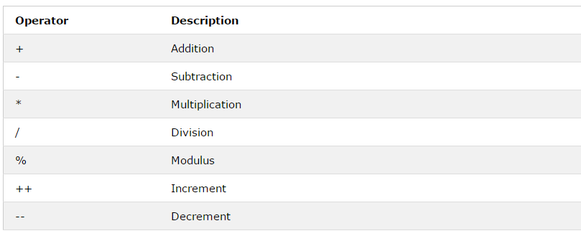
Javascript Mathematical Operators

Slide 19
Class Exercise
1. Use JavaScript to evaluate Circumference of a Circle using the Diameter.
Given that π = 3.14 and d = 12
The formula is simply this: C = πd.
Display the result using console.log()
And alert box.

Slide 20
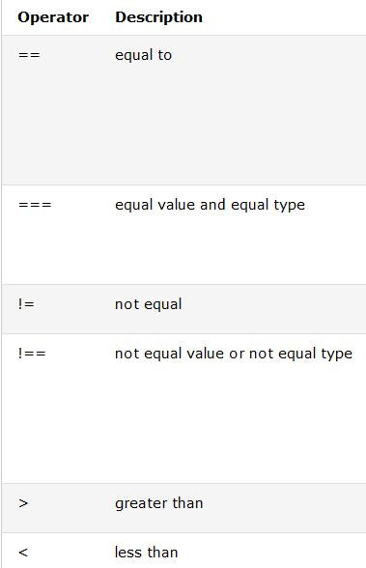
Javascript Comparism Operators

Slide 21
Javascript Events and Inline Placement
HTML events are "things" that happen to HTML elements, It can be something the browser does, or something a user does.
Example is: HTML button was clicked
When events happen, you may want to do something.
JavaScript lets you execute code when events are detected.
When JavaScript is used in HTML pages, JavaScript can "react" on these events.
Syntax : <HTML Tag some-event="some JavaScript">

Slide 22
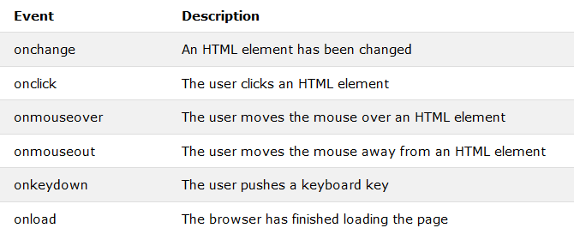
JS Events

Slide 23
JavaScript Popup Boxes
JavaScript has three kind of popup boxes: Alert box, Confirm box, and Prompt box.
Alert Box: often used if you want to make sure information comes through to the user.
When an alert box pops up, the user will have to click "OK" to proceed.
Syntax: window.alert("sometext");
Exercise: Using JS alert box, add a welcome message to your website
Notes:
The window.alert box can be written without the window prefix
Ponder: GTB e-banking platform alert

Slide 24
JavaScript Popup Boxes
Confirm Box: often used if you want the user to verify or accept something.
When a confirm box pops up, the user will have to click either "OK" or "Cancel" to proceed.
If the user clicks "OK", the box returns true. If the user clicks "Cancel", the box returns false.
Syntax: window.confirm("sometext");
Notes:
The window.confirm() method can be written without the window prefix.
Usually used to confirm deletion

Slide 25
JavaScript Popup Boxes
A prompt box is often used if you want the user to input a value before entering a page.
When a prompt box pops up, the user will have to click either "OK" or "Cancel" to proceed after entering an input value.
If the user clicks "OK" the box returns the input value. If the user clicks "Cancel" the box returns null.
Syntax: window.prompt("sometext","defaultText");
Notes:
The window.prompt() method can be written without the window prefix.

Slide 26
Exercise
Based on your understanding of Javascript variables and the pop up boxes, get the name of a visitor to your website and greet him/her mentioning their names
Hint : prompt boxes
Notes:
<script type="text/javascript">
var name = window.prompt("Please Enter Your Name");
alert(name +" Thank you for visiting my site");
</script>

